Slide 1
Flash Bids
Live Flash Auctioning System
Mentor: Geetika Bandlamudi
Arsalan Anwar | ax2134
Affan Arif Khamse | ak10529
Aditya Mittal | am13294
Jugal Pumbhadia | jp6988

Slide 2

Agenda
Introduction
Demo
Key Features
System Architecture
Results & Impact
Future Work

Slide 3
Introduction
Flash Bids: A cloud-powered, real-time auctioning system designed for low latency bid placement and seamless product auctioning!

Slide 4
State of Current Auction Platforms
How Flash Bids Stands Out
Latency Issues: Platforms like eBay Live Auctions might experience delays, disrupting real-time bidding and user trust.
Sniping Practices: Lack of mechanisms to prevent last-second bids results in unfair advantages.
Scalability Limitations: Struggle to handle high traffic during peak auction times, leading to poor user experience.
Low-Latency Architecture: Real-time updates powered by WebSockets ensure instant bid processing and notifications.
Sniping Prevention: Automatic auction extensions create fairness by eliminating last-second advantages.
Scalable AWS Infrastructure: Auto-scaling with load balancing handles dynamic traffic effortlessly, ensuring reliability.

Slide 5
Demo
https://flash-bids.com/

Slide 6
Key Features

Slide 7
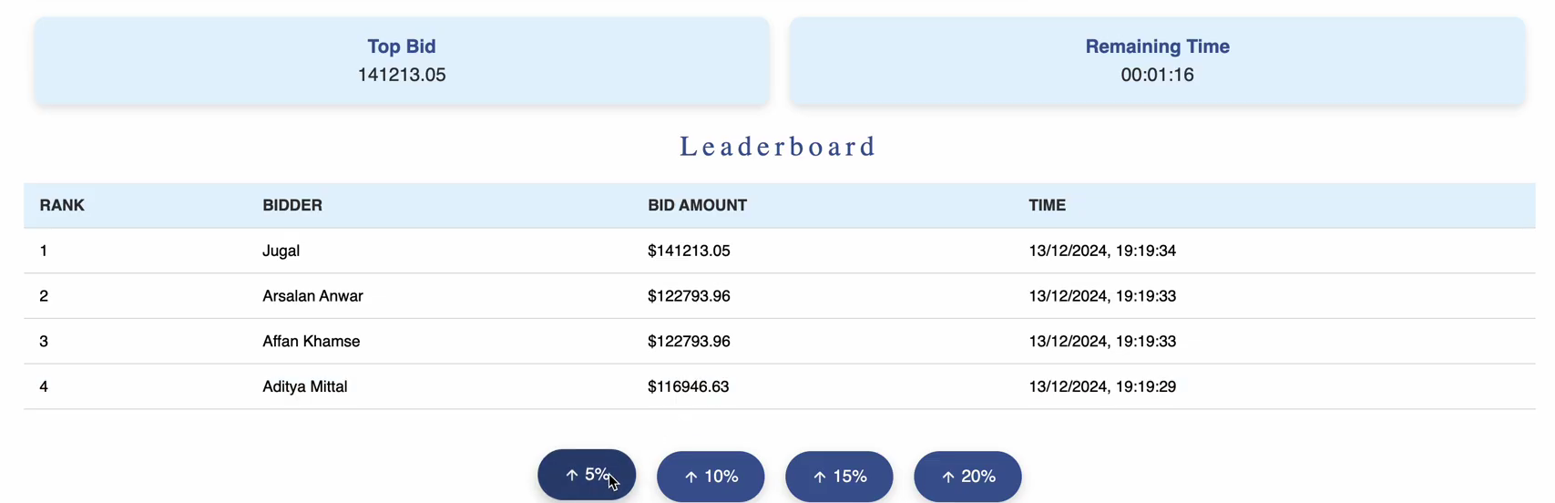
Real-Time Bidding Mechanism
Real-time bid submissions are powered by WebSockets, ensuring low-latency communication for a smooth experience.
Concurrent bids are processed efficiently to maintain fairness and accurately identify the highest bidder.

Slide 8

Dynamic Countdown Timer
A synchronized timer ensures all users see the exact remaining time, fostering a level playing field.
WebSocket-powered updates eliminate discrepancies caused by network or device delays.

Slide 9
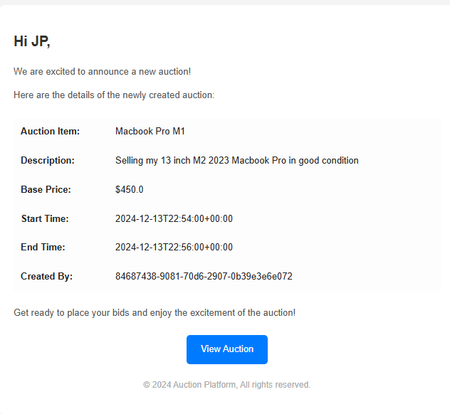
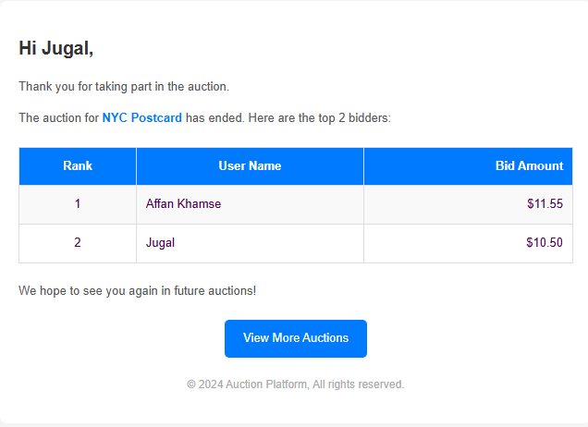
Auction Notifications
Seamless integration with Amazon Simple Email Service (SES) to keep users informed
Users notified for upcoming auctions and results of participated auctions

Slide 10
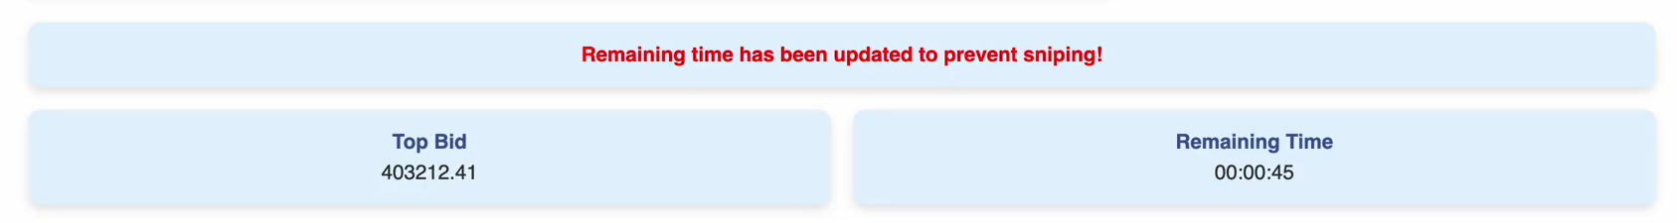
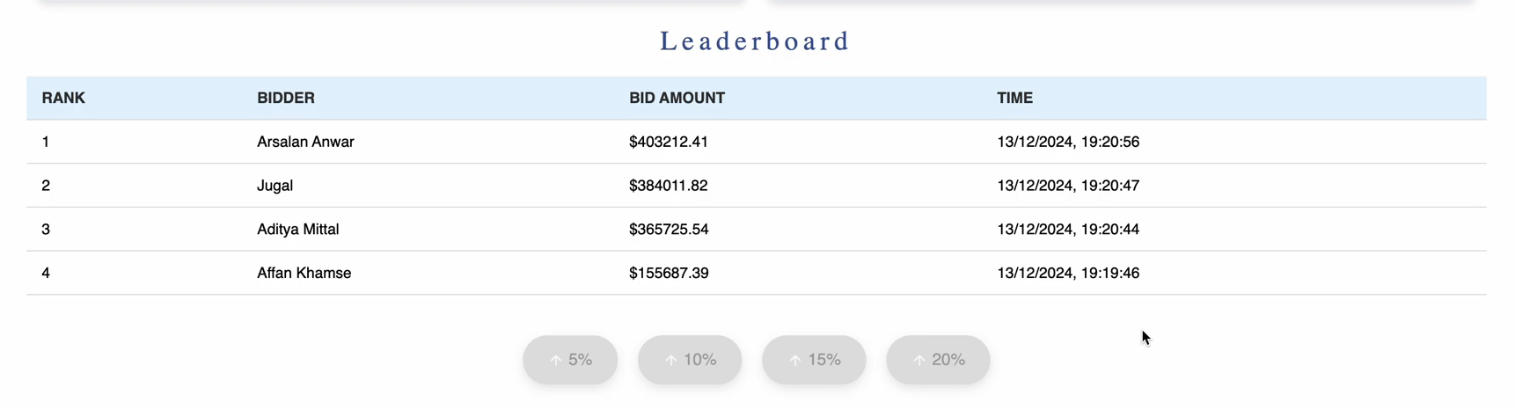
Sniping Prevention and Rate Limiting
Timer extends near the auction end to counter last-second “sniping” tactics
This extension is communicated to all users immediately, giving everyone a fair opportunity to respond.
Users are rate limited by not allowing them to outbid their own top bids

Slide 11
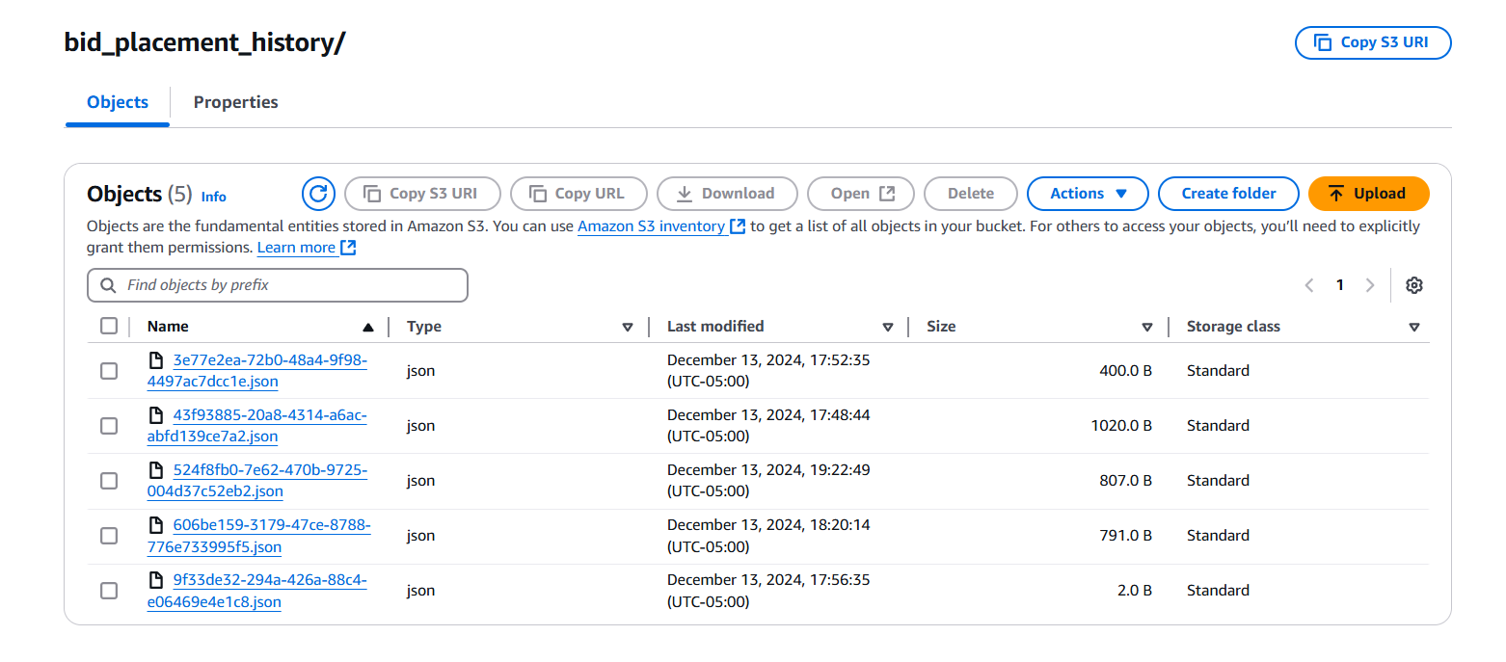
Post Auction Analytics
AWS EventBridge trigger compiles the complete bidding history to Amazon S3 bucket.
This allows stakeholders to examine bidding patterns, participant engagement levels, and other metrics.

Slide 12
System Architecture

Slide 13
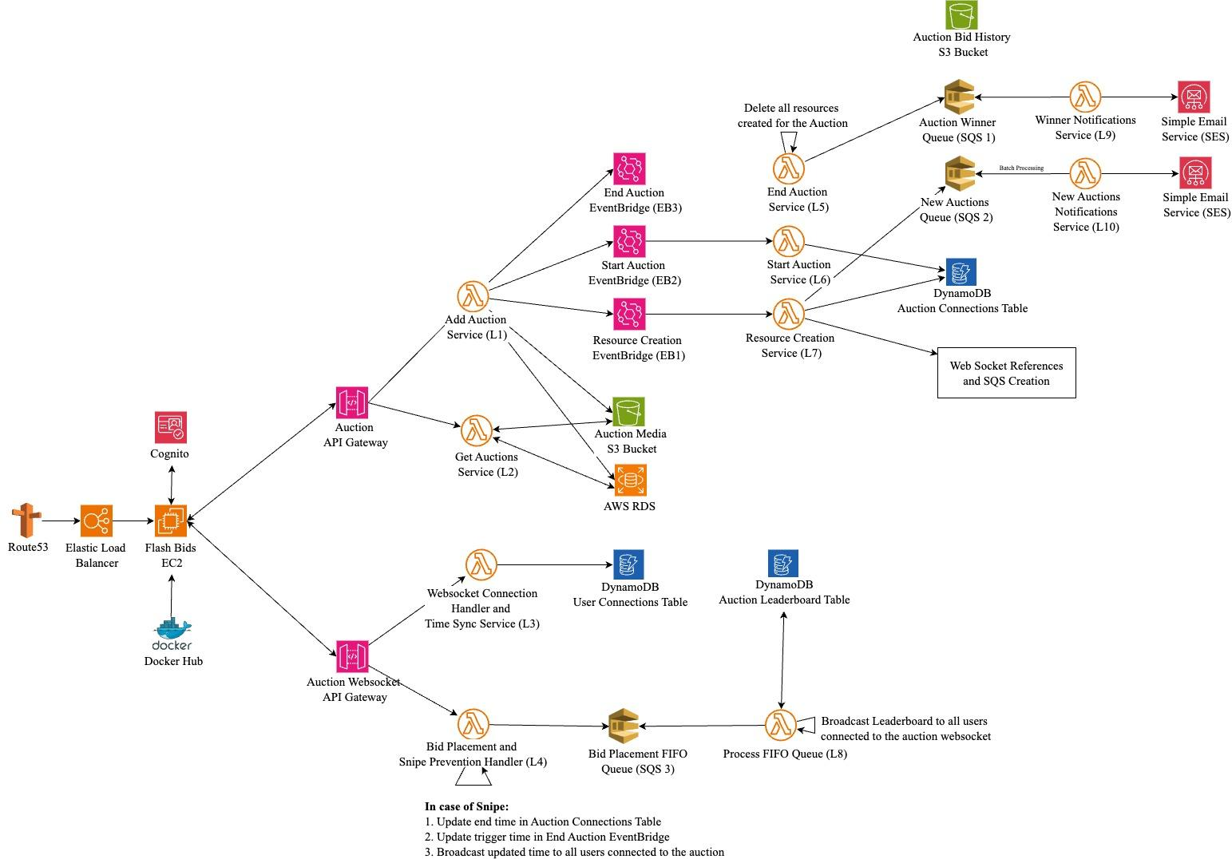


Slide 16
Conclusion

Slide 18


Results & Impact
P A R T 0 4
Performance: Real-time auction updates and low-latency user interactions are achieved through WebSocket connections, efficient DynamoDB tables, and optimized SQS queues, ensuring a seamless user experience even during high transaction volumes..
Reliability: The system ensures reliability with sniping prevention mechanisms, FIFO queues for orderly bid processing, and Lambda-based workflows that handle failures gracefully, maintaining data consistency and uninterrupted auction operations.

Slide 19


Results & Impact
P A R T 0 4
Scalability: The architecture leverages an Elastic Load Balancer and auto-scaling EC2 instances to dynamically adjust resources based on traffic demands, ensuring smooth scaling for peak and off-peak auction activity.
Availability: High availability is ensured through a combination of auto-scaling EC2 instances to handle fluctuating traffic demands, Elastic Load Balancer for even distribution of incoming requests, and redundant S3 storage for auction media. Real-time connectivity is further maintained through WebSocket-based bidirectional communication, ensuring uninterrupted access and updates for users during live auctions.

Slide 20



Future Enhancements
P A R T 0 4
Native mobile apps for broader accessibility
AI-driven recommendations and fraud detection
Globalization: Multi-language support & regional payment methods

Slide 21
Team Contributions
Functionality | Aditya Mittal | Affan Arif Khamse | Arsalan Anwar | Jugal Pumbhadia
Real-Time Bidding Mechanism | ✔ | ✔ |  | ✔
Dynamic Countdown |  |  | ✔
Auction Infrastructure Spin-up | ✔ | ✔ |  | ✔
Leaderboard Broadcasting | ✔ |  | ✔
Notifications |  | ✔ | ✔ | ✔
Sniping Prevention and Rate Limiting | ✔ |  | ✔
API Configuration |  | ✔ | ✔
Frontend (UI) | ✔ | ✔ |  | ✔
Backend & Deployment |  | ✔ | ✔ | ✔

Slide 22
Thank you
Questions?

